Slide 1

Section # 01
Sidra Tul Muntaha | Code in Place | 2024
Week 1 [April 26, 2024]

Slide 2
Welcome to section!
Sidra Tul Muntaha | Code in Place | 2024

Slide 3

About me
Sidra Tul Muntaha | Code in Place | 2024
My name is Sidra Tul Muntaha.
I am majoring in Electrical Engineering and working as a Control Panel Design Engineer.
In In my free time I like to explore new things.
I enjoy Sketching & Drawing.

Slide 4
About you!
Sidra Tul Muntaha | Code in Place | 2024
Go ahead and share:
Your name
Where you’re tuning in from.
Your professional/educational background.

Slide 5
Control Flow
Sidra Tul Muntaha | Code in Place | 2024

Slide 6
Control flow
Sidra Tul Muntaha | Code in Place | 2024
if
if/else
for
while

Slide 7
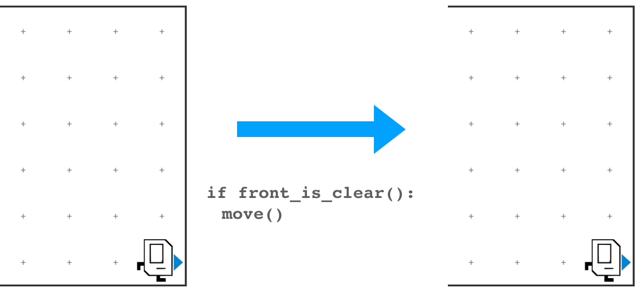
Control flow
Sidra Tul Muntaha | Code in Place | 2024
if
Do something when a condition is met.
if/else
for
while

Slide 8
Control flow
Sidra Tul Muntaha | Code in Place | 2024
if
if/else
for
while

Slide 9
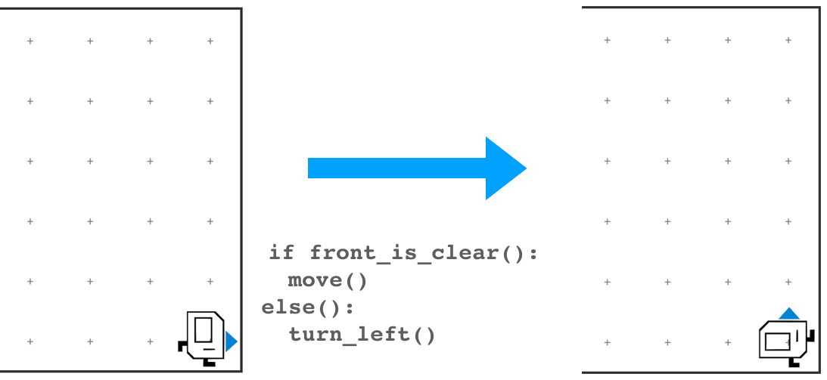
Control flow
Sidra Tul Muntaha | Code in Place | 2024
if
if/else
Also do something else when a condition is not met.
for
while

Slide 10
Control flow
Sidra Tul Muntaha | Code in Place | 2024
if
if/else
for
while

Slide 11
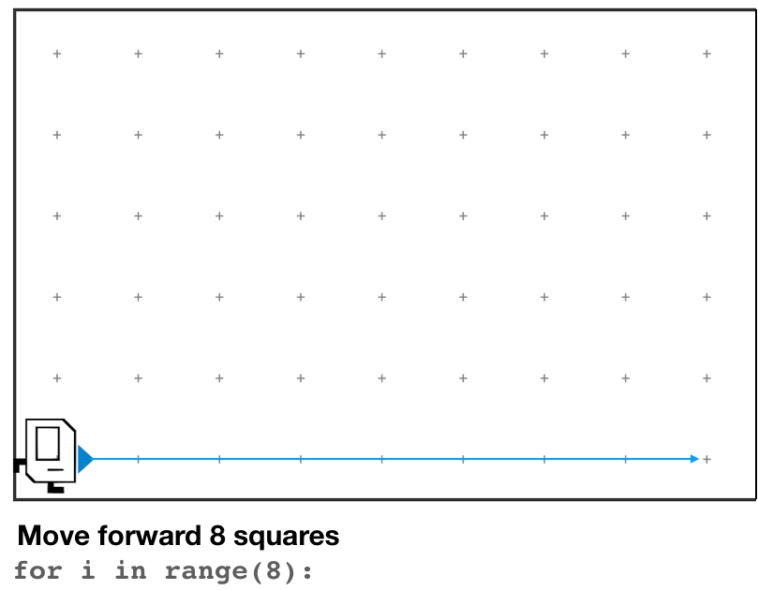
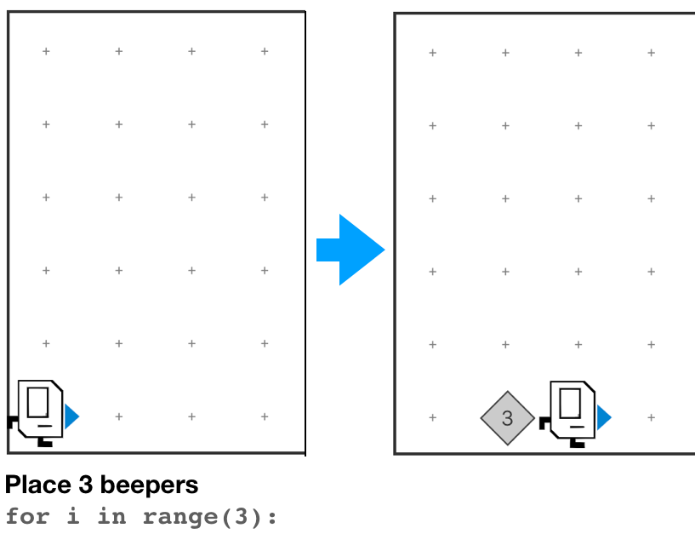
Control flow
Sidra Tul Muntaha | Code in Place | 2024
if
if/else
for
Do something a set number of times.
while

Slide 12
Control flow
Sidra Tul Muntaha | Code in Place | 2024
if
if/else
for
while

Slide 13
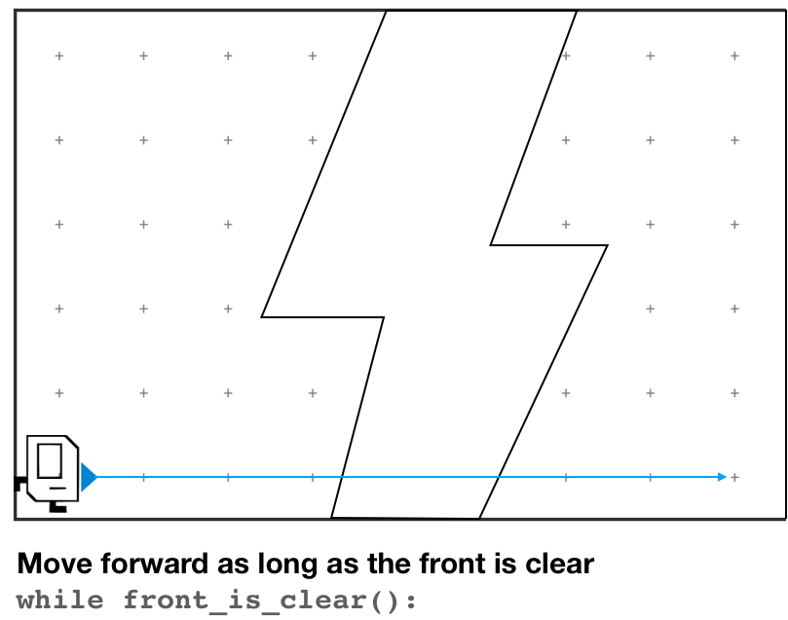
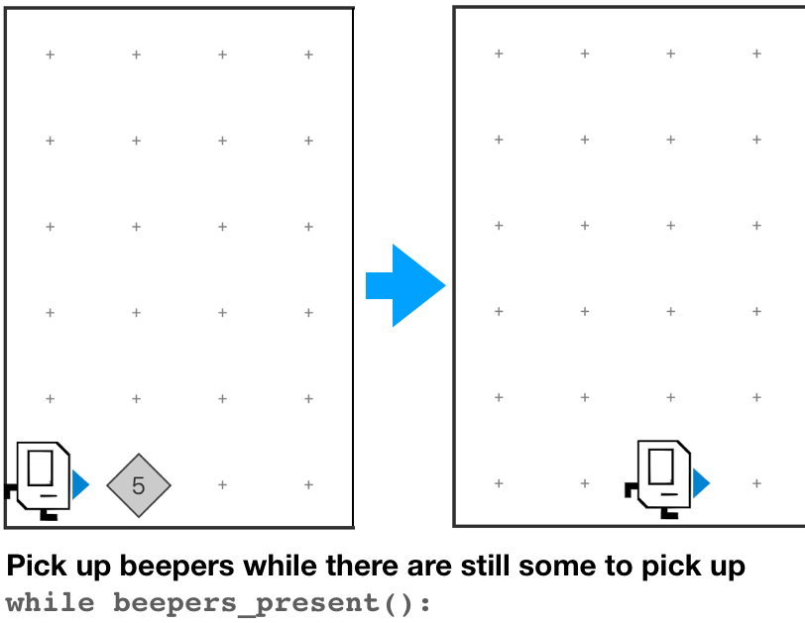
Control flow
Sidra Tul Muntaha | Code in Place | 2024
if
if/else
for
Do something until condition is no longer true.
while

Slide 14
Control flow
Sidra Tul Muntaha | Code in Place | 2024
if
no
Do you have a backup plan?
yes
if/else
yes
Is it a one-off?
for
yes
Do you know how many times you need to do it?
no
while
no

Slide 15
Base Karel commands
Sidra Tul Muntaha | Code in Place | 2024
move()
turn_left()
put_beeper()
pick_beeper()

Slide 16
Conditional Karel commands
Sidra Tul Muntaha | Code in Place | 2024
front_is_clear() beepers_present() beepers_in_bag() left_is_clear() right_is_clear() facing_north() facing_south() facing_east() facing_west()
front_is_clear()
beepers_present()
beepers_in_bag()
left_is_clear()
right_is_clear()
facing_north()
facing_south()
facing_east()
facing_west()
front_is_blocked()
no_beepers_present()
no_beepers_in_bag()
left_is_blocked()
right_is_blocked()
not_facing_north()
not_facing_south()
not_facing_east()
not_facing_west()

Slide 17
Sidra Tul Muntaha | Code in Place | 2024
Hospital Karel
Notes:
Sent out a poll to choose a section name. Let’s check out the submissions:

Slide 18
Setting Context
Countries around the world are dispatching hospital-building robots to make sure anyone who gets sick can be treated. They have decided to enlist Karel robots. Your job is to program those robots.
Sidra Tul Muntaha | Code in Place | 2024

Slide 19
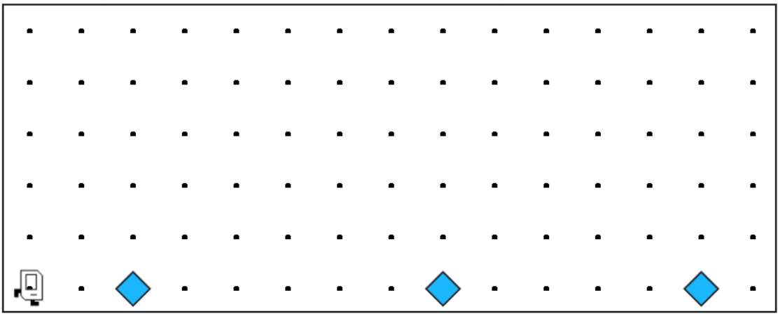
Sidra Tul Muntaha | Code in Place | 2024
Each beeper in the figure represents a pile of supplies.

Slide 20
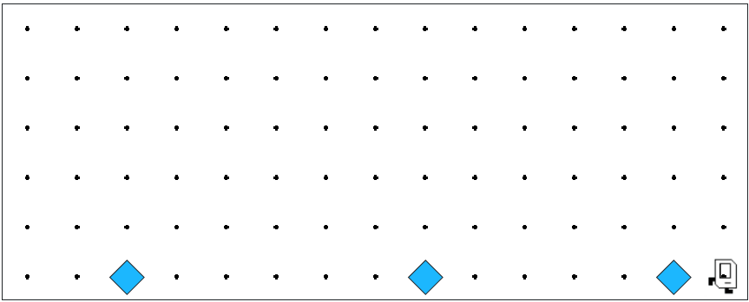

Sidra Tul Muntaha | Code in Place | 2024
Karel’s job is to walk along the row and build a new hospital in the places marked by each beeper.

Slide 21

Sidra Tul Muntaha | Code in Place | 2024
Hospitals look like this: a 3x2 rectangle of beepers!

Slide 22
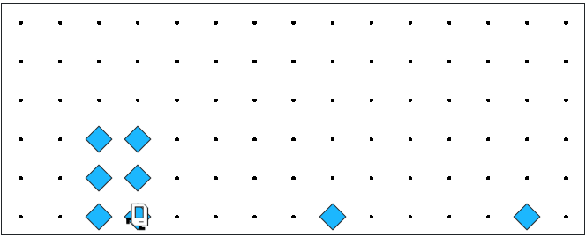
Sidra Tul Muntaha | Code in Place | 2024
The new hospital should start from the point at which the pile of supplies was left.

Slide 23
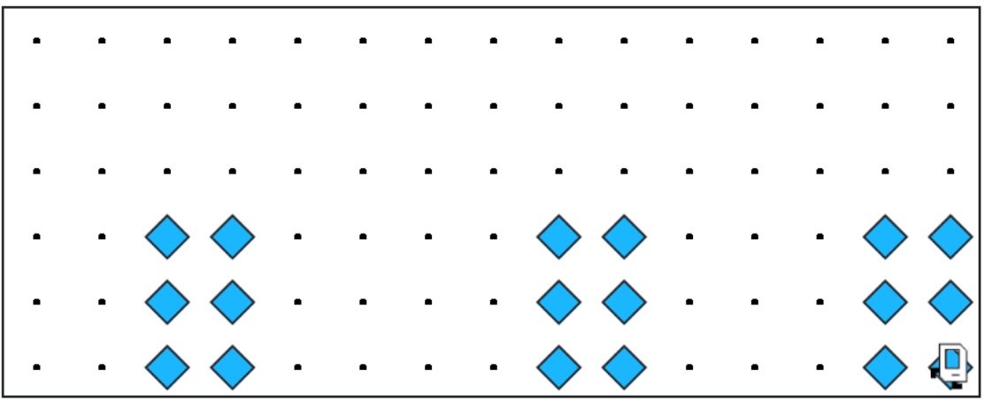
Sidra Tul Muntaha | Code in Place | 2024
At the end of the run, Karel should be at the end of the row having created a set of hospitals. For the initial conditions shown, the result would look like this:

Slide 24
Notes to Keep in Mind
Sidra Tul Muntaha | Code in Place | 2024
Karel starts facing east at (1, 1) with an infinite number of beepers in its beeper bag.
The beepers indicating the positions at which hospitals should be built will be spaced so that there is room to build the hospitals without overlapping or hitting walls.
There will be no supplies left on the last column.
Karel should not run into a wall.
Notes:
Sent out a poll to choose a section name. Let’s check out the submissions:

Slide 25
Questions Before We Begin?

Slide 26
Let’s get to work!

